Slide 1

Basic Details of the Team and Problem Statement
Problem Statement Title: Moving vehicle registration plate detection and unauthorized vehicle detection in secure premises
Team Mentor: Abhishek Bal
Team Leader Name: Rahul Karmakar
Team Member 1: Soumya Kapat
Team Member 2: Soumyajit Banik
Team Member 3: Sneha Chakraborty
Institute Name: Future Institute of Engineering and Management

Slide 2
Research gap
Based on the internet study and existing research paper analysis, we found that either the car was recognized using a registration number plate or detected using RFID but both aren’t used simultaneously for verification but the problem is that it may be possible that two vehicles exchange registration plates for nefarious reasons, such as theft or forgery, which can be challenging to identify. To overcome this kind of situation, we can verify RFID and registration plates simultaneously and also keep logs of vehicles that enters and exits the compound which becomes very important in case of tracking runaway vehicles.

Slide 3


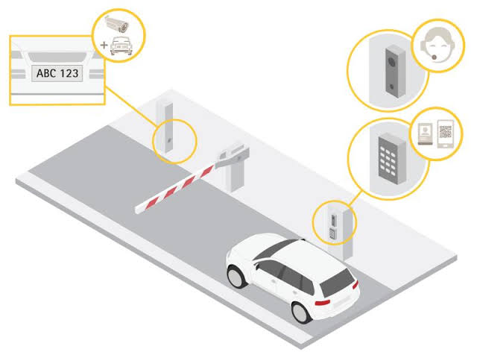
AIM of the project
The aim of this project is to implement a security system which can verify the authenticity of a vehicle.
This authentication is done in few steps:
First, we scan the unique RFID key which is associated with every vehicle.
Second, we extract the license plate number from the CCTV feed by using a Deep Learning based OCR library.
Then we check authenticity by cross verifying the RFID key associated with the license plate number of the vehicle.
If authentication is successful we keep a log of that vehicle in our database, else we recommend human intervention.

Slide 4









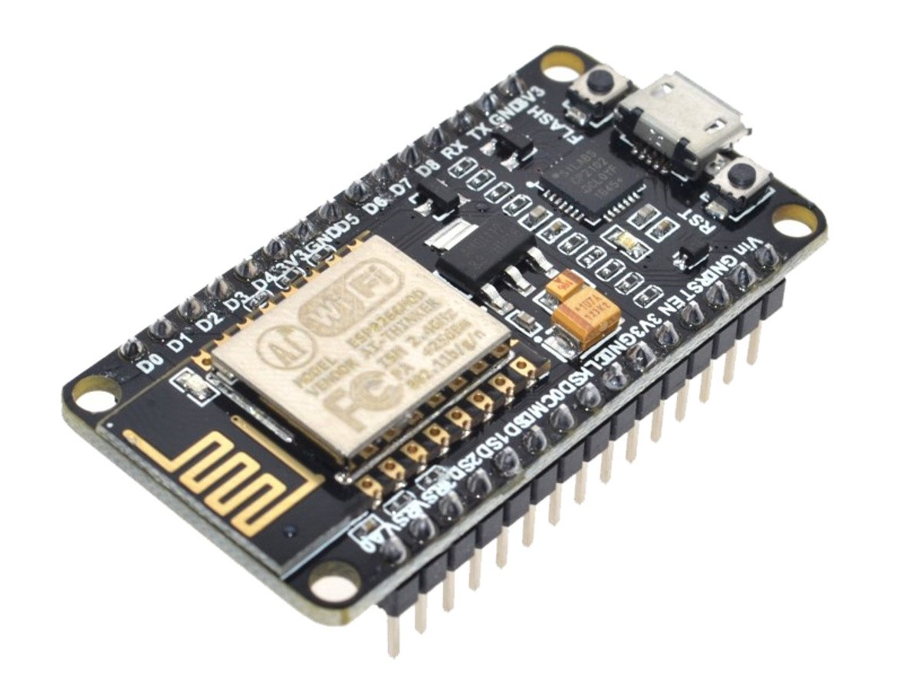


Proposal of our Idea
Moving vehicle registration plate detection is an image processing innovation task that checks the legitimacy of the vehicle by using the vehicle's registered number plate and radio frequency identification (RFID) as well as it also helps to detect the unauthorized vehicle in secure premises.
The goal is to match the details of the RFID tag to the vehicle registration number plate in order to plan a vehicle distinguishing proof structure that has been approved by the manufacturing programme.
We develop an anti-theft auto security system that can extract the vehicle registration number from the number plate by the webcam with the help of a deep learning based OCR model and then match it with the RFID tag in order to plan a vehicle distinguishing proof structure that has been approved by the authority. An organization's entry and exit point's security will be implemented by using this framework.
We develop a custom trained model by various types of images of registration plate which can recognize the registration plate from each and every frame and this model is a universal model and can run in every platform. This model consists Darknet and YOLO. Then by using openCV, numpy and other python libraries we can detect registration plate from live CCTV footage or from any recorded video footage. Next we develop a deep learning based OCR technique to extract the registration number as a string from the number plate of the moving vehicle.
Python
YOLO
IDE Browser
RFID
CCTV Camera
Node MCU
Software
Hardware

Slide 5



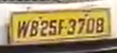
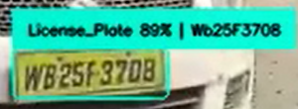
Optical Character Recognition:
Optical character recognition or optical character reader, often abbreviated as OCR, is the mechanical or electronic conversion of images of typed, handwritten or printed text into machine-encoded text, whether from a scanned document, a photo of a document, a scene-photo (for example the text on signs and billboards in a landscape photo) or from subtitle text superimposed on an image (for example from a television broadcast).
OCR

Slide 6
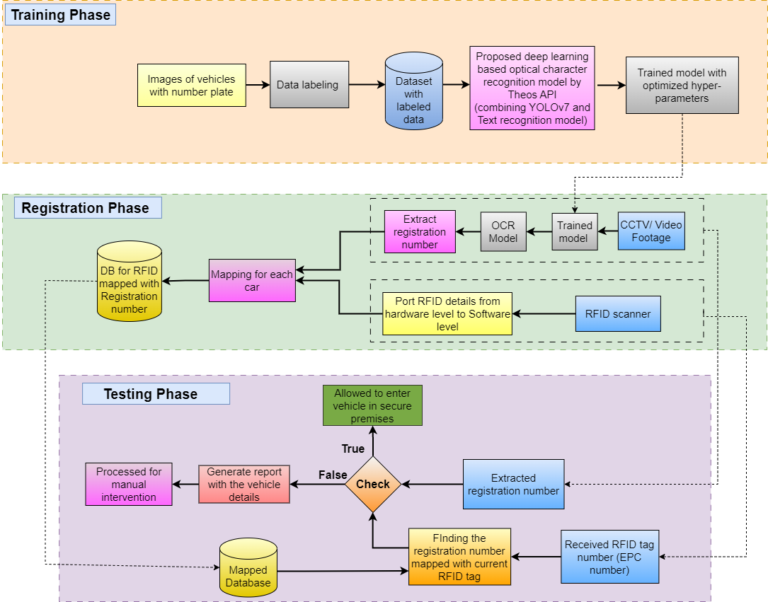
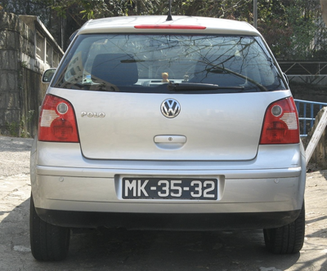
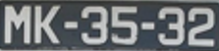
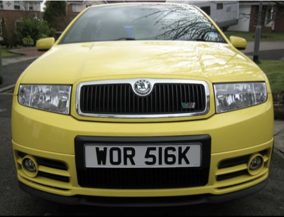
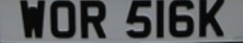
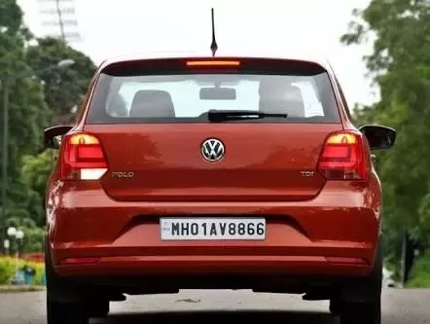
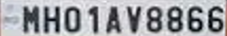
Flow Chart

Slide 7
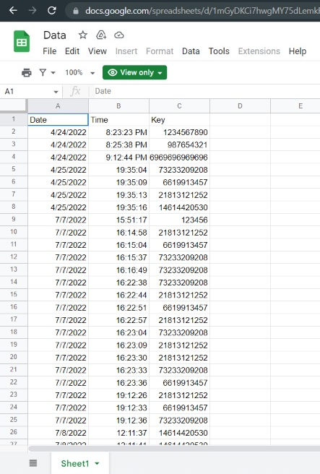
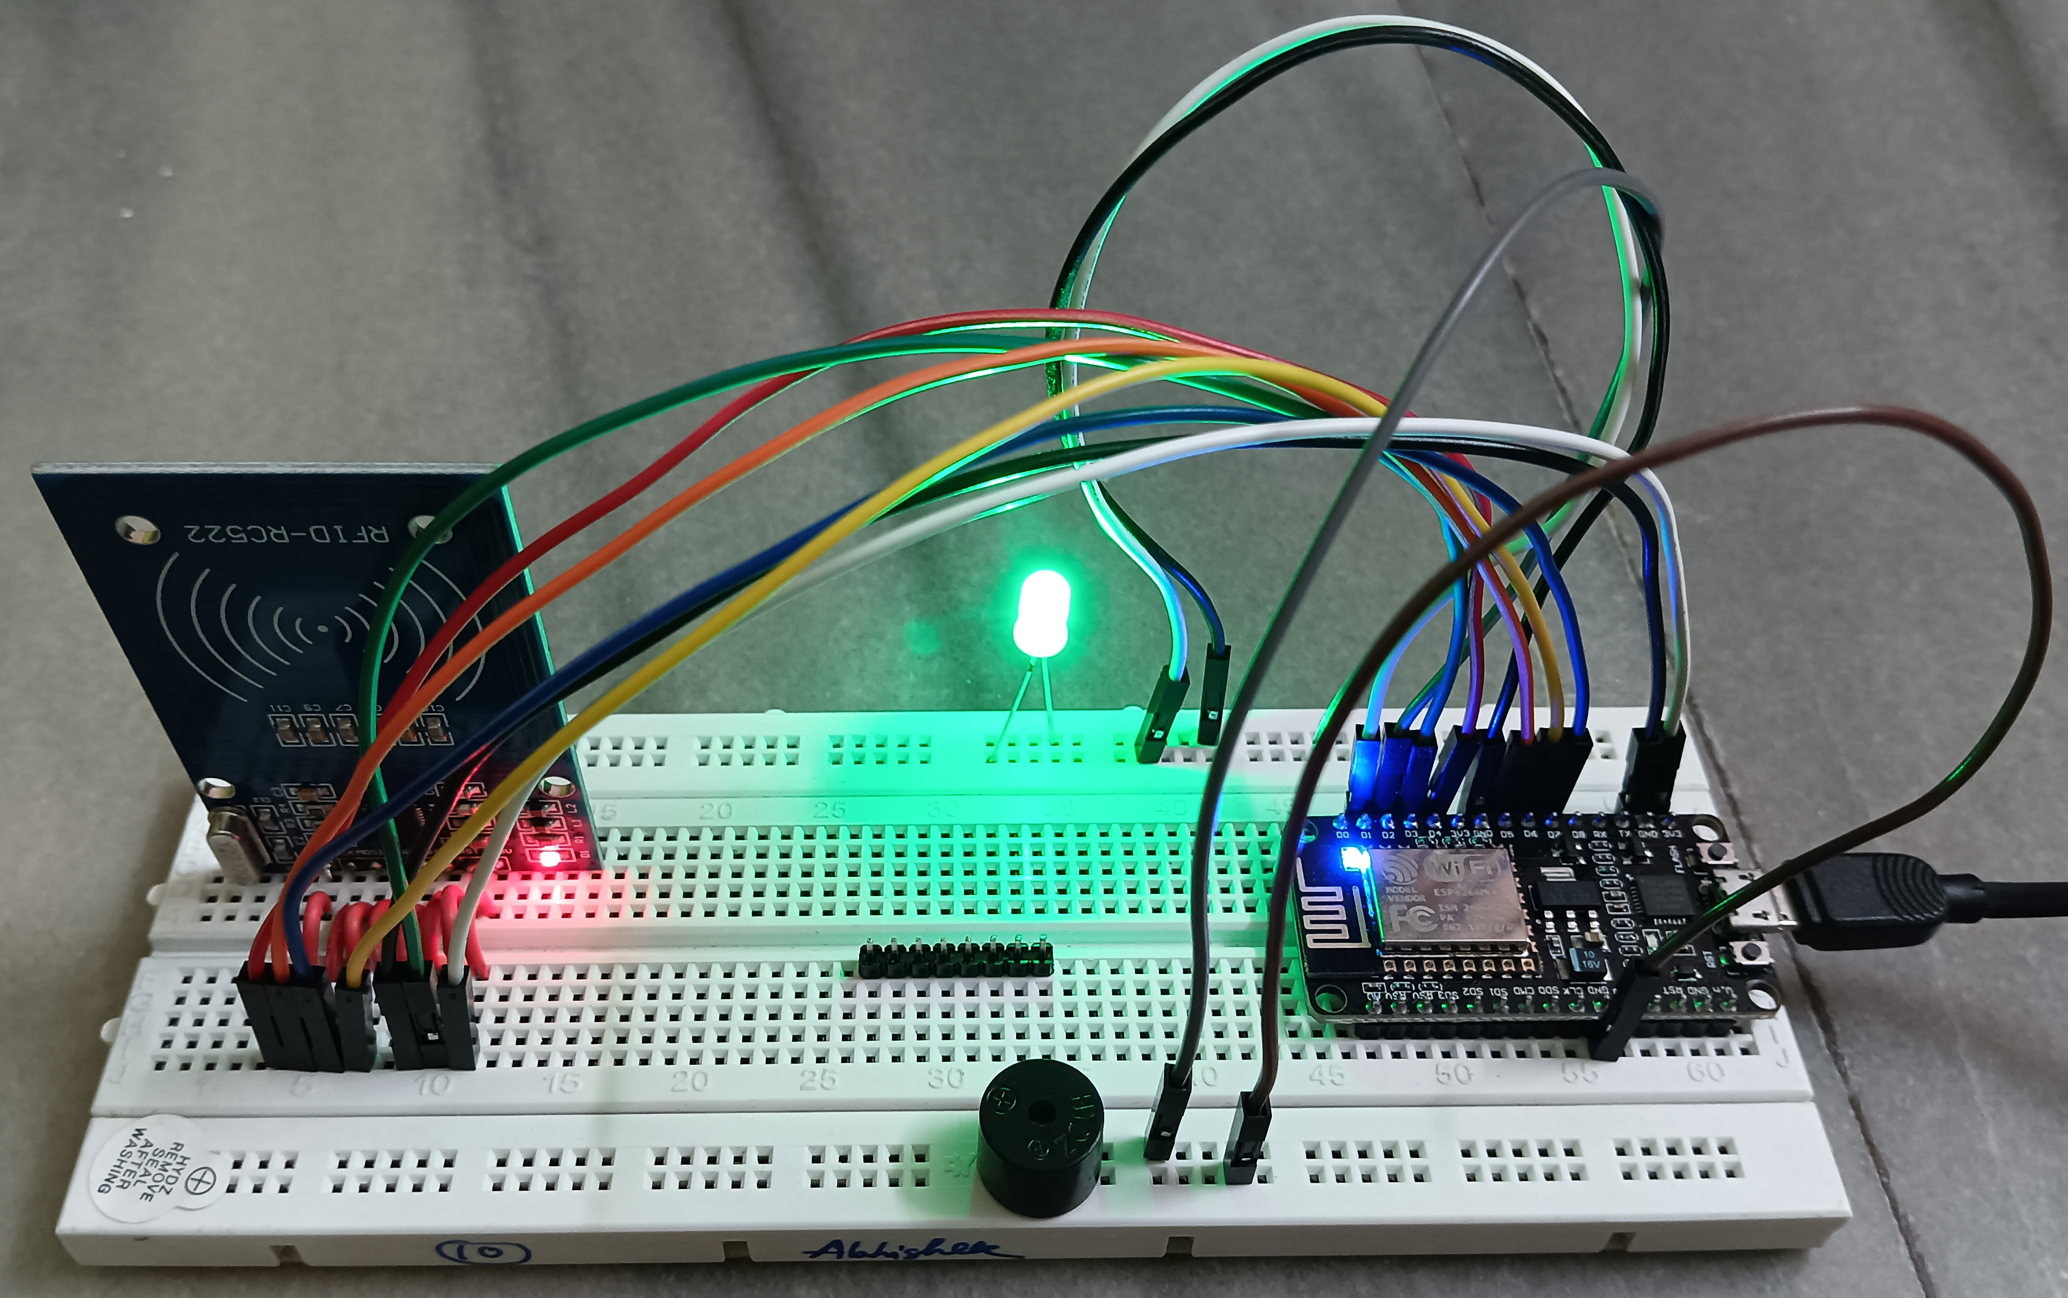
RFID hardware implementation
Uploaded RFID tag details

Slide 8
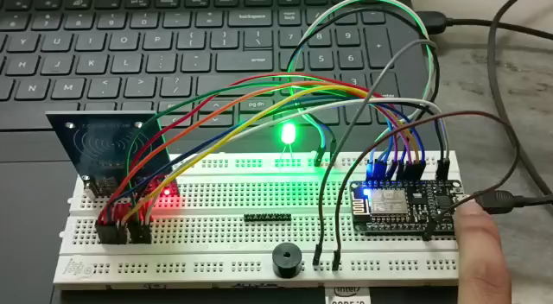

Implementation of RFID details reading

Slide 9
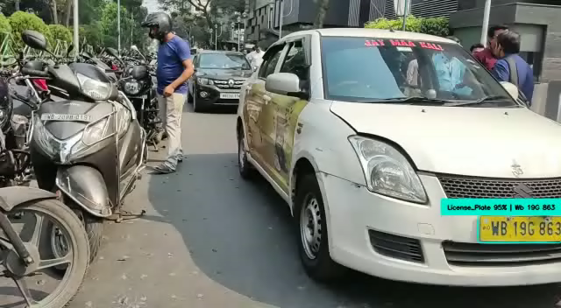
Creating bounding box around the registration plate of car and extract the registration number by OCR

Slide 10
Result Analysis
The project recognizes the accuracy percentage of the number on the registered number plate which is detected by OCR and then checks that whether the number of the registered number plate detected by OCR is mapped to the RFID of the vehicle. Our initial approach to form an authentication-based system was by detecting registration number plate from the image of the vehicle received from CCTV feed and also fetching the RFID tag details of that vehicle.
Many problems and accuracy issues were faced while we tried to implement this authentication system. This authentication system when used for a less noisy vehicle image with a less polluted environment and proper weather gives more accuracy. An extremely polluted environment or foggy weather can result in a low accuracy of OCR prediction. In case of a blurred image of the vehicle number plate, we can detect it by layer detection technique. But it’s recommended for the system to be used in a less polluted environment in order to get good accuracy.

Slide 11
Future Scope
This technology can be implemented where privacy and security need to maintain properly. We can prevent to entry or exit unauthorised vehicle
If a car is stolen, an authorized user should log a report into the server, and a network of RFID scanners installed in various check points, traffic signals, and toll plazas throughout the city will search for the reported tag. Once the necessary security system has been discovered, the car will be arrested.
We want to improve our system by which extract the vehicle information in case of highly polluted area or any place where visibility is poor.
Dependency
Extremely polluted environment or fog can result in low accuracy of OCR predictions.

